Slide 1

SIMPLE CALCULATOR
BY PYTHON GUI TKINTER
Asha Sandeep
Noida
Digicrome Academy.

Slide 2
Project Overview
My purpose is to make a creative “Simple Calculator” using tkinter module
Timeline :- 11th feb,2024.
Deadline :- 11th march,2024.

Slide 3
Problem Statement
When i was working on this project i faced some problem
like “Syntax” error and “Identation mistake in the code.
I also faced the problem in making the display entry ,columnspan,ipadx.

Slide 4
Solution
When I occured a problem in this project.I got solution on those problems from the tkinter gui and it solved .

Slide 5
Methodology
I used three methods in this project:-
Grid method():-
Geometry method():-
Pack method ():-

Slide 6
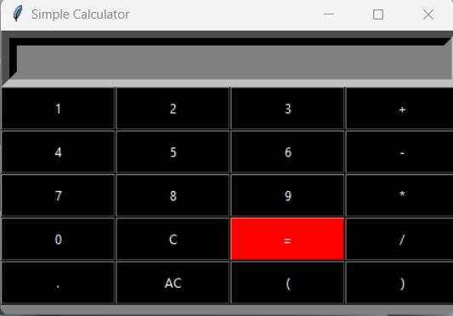
Key features
List of main features of the calculator:
Addition
Subtraction
Multiplication
Division

Slide 7
Result & Achievements
Finally I got the result of the simple calculator and achieve
the output .

Slide 8
Challenges faced
I faced challenges in this project for add the new button in
it . when I r & d in the tkinter gui python program how to make a simple calculator I got the solution on this problem.

Slide 9
Conclusion
I learned how to create a Simple GUI Calculator application using the tkinter module in python.
The most important function is the eval function which parses the string expression and evaluates the result.
we must create the mainframe display widgets and the buttons which are required for arithmetic operation in a
calculator.
Event triggers must be added to the widgets to make them functional
Encouragement to explore more Python projects and continue learning

Slide 10
Thank you

